Slide 1
How to Research: Propellor Example
Workshop 11/22 ; Theme: old white men
Notes:
Feedback from last time:
Ideas for more workshops:
Learning curves
How to attack designing things
Example leading edge,
Generally more in depth of how to design
General ideas for improvements:
Newer concepts : a work day would be helpful
More interactive in general as well

Slide 2
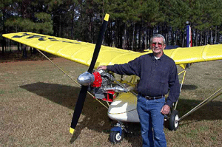
Prompt/Activity:
Imagine we’re in charge of designing the propeller, meaning dimensions rpm, power going to it, all the things + things I have no idea of
Everyone together: Research propellers for 15 minutes
Collaboration all throughout
You’re trying to get an idea of
Restrictions
Concrete data of other propellers
How we would go about designing ours

Slide 3
Overview of Information Learned:
Materials + Types
Wood lighter→ best for our use
Propellor extension, helps with cooling
Fixed propellor → ours, cheap, light, easy to maintain
Legal Eagle + Other planes
Shrink fit propeller hub + 20 mm bolt
Lower powered engine → lower number of blades
More efficient, don’t need the extra weight of extra blades
Higher power → higher blades

Slide 4
Overview of Info learned
Larger diameter → lower the rpm
Need to take into consideration the tilt of the diameter
Thrust vs companies
And take off/climb information
Vibration of the propellor
Motor / battery

Slide 5
Take notes here
All together!

Slide 6
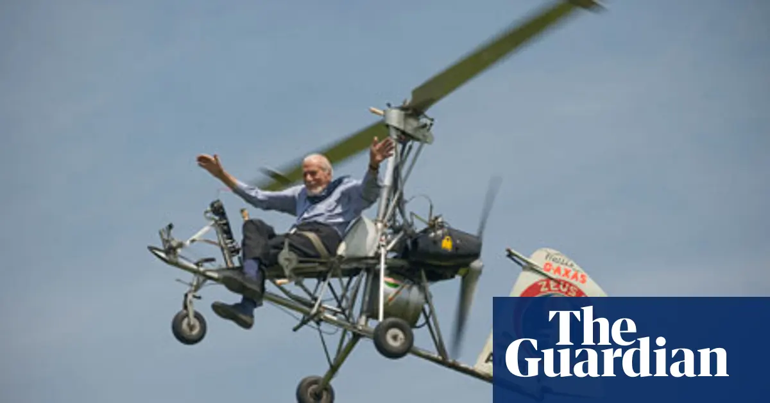
Hopes for this
We’ll all see how others research
How to be an efficient researcher
Teamwork
Learning curve can be overcome together
The power of 15 minutes
Idk you guys said more interactive and design process so combination?
Experiment lets see how this goes
We have a sum total of 1 hour of research on the propellor so good info for later anyways

Slide 7
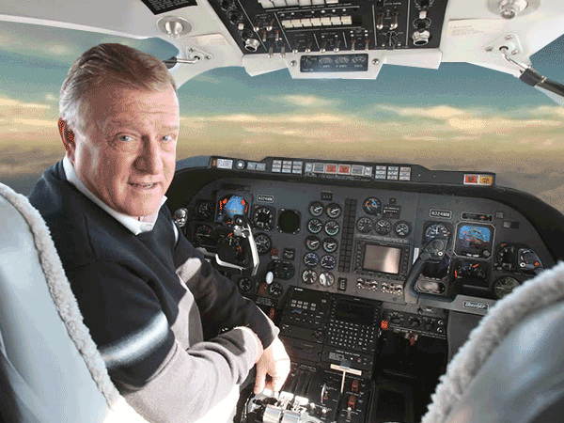
Clarifications
If you need existing data for design things: ask me
If it’s a physics thing: i definitely won’t know your answer but i’ll let you know if someone knows the number or not
If we don’t know it- congrats! This is a joint design + physics team problem! (which they usually are)
Use literally anything, things in our drive, the interwebs
Everybody doesn't have to be on the same website, we can divide and conquer

Slide 8

Ideas for Research
Dimensions
Material
Placement
Rounds per minute
Energy necessary
Amount of thrust it generates
What do other planes do
What is generally done for ultralights

Slide 9
5 mins reading through previous research!
Choose something you want to expand upon!
Or choose a source you want to explore
Yes i make words larger when slides look empty lol

Slide 10
Qs? If not, 15 min timer time!

Slide 11
Physics things from Matt: Viscosity
How thick something is
Think maple syrup vs water
If you go up to a high enough speed: cavitation
Extreme thing that probably won’t happen: Cavitation: Blade moves so quick that air can’t come in
Important to balance number of blades + pitch + RPM

Slide 12
Kyle Info learned!
Optimal number of blades is 2 → minimum we can fly with
Don’t want >2 bc force generated is not proportional to drag generated
2 is optimum
2x blades =\ 2x thrust bc same amount of viscous air
2x blades ~= 2x drag bc twice the amount of surface area which creates the drag
In some cases 3/4 is good ← need more research

Slide 13
Blade Properties
How do the different properties of a propeller (diamter, blade angle, material, etc.) affect the amount of thrust generated with the same amount of revolutions? - Agastya
DIAMETER: A propeller with a longer diameter will typically also have a greater surface area, which allows it to pass through greater amounts of air and therefore create more thrust
More pitch
MATERIAL: The greater the weight of propeller material, the more energy will be required, but there will also be a greater amount of thrust generated due to how the heavy material has higher friction with the air
Blade angle is very complicated! oof!

Slide 14
Jasmine Info!
Fixed pitch propellor: good climb performance ← sacrifices speed
Propellor is directly proportional to engine power
Can’t change after take off
Ground adjustable propellor is good for experimental aircrafts!! Us!!

Slide 15
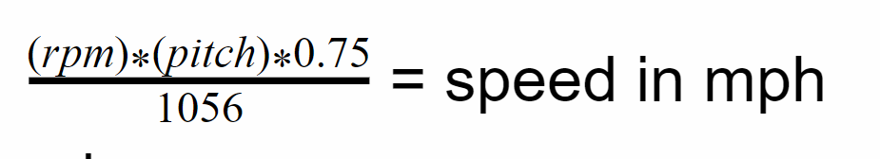
Maya info:
Equation to get pitch from diameter & height: pitch = 2.36 (diameter height)/width
Equation from pitch, rpm to get speed:
Rearranged desmos

Slide 16
Main helpful sources:
Textbook + http://avstop.com/ac/flighttrainghandbook/basicpropellerprinciples.html
Not a primary resource: Legal Eagle was not helpful for design, just for reference
textbook , physicy not very helpful
http://www.ultralightnews.ca/articles/ultralightpropeller_comparison.htm
Diff websites helpful
https://www.aircraftspruce.com/catalog/appages/ultraprop.php
https://ultraprops.com/
https://www.homebuiltairplanes.com/forums/threads/propellor-design.33900/

Slide 17
Feedback on activity?
New:
*kyle nods head* I MEANT IT WAS GOOD
*awkward silence*
Agastya: I really liked the structure and the research time
Crispy feedback
Old:
*Sheelyn nods head*
Useful for learning + researching
Variety of resources good
To make better: More time
Took a lot of time navigating the different souces
Good unstructured
All participated

Slide 18
Mkay, lesson time

Slide 19
Our Most Helpful Written Resources

Slide 20
Textbooks
The General Aviation Aircraft Design (AKA: “The textbook”)
Good gems of information, things to consider
SUPER Convoluted and Mathy
Advisory Circular
Great requirements,
Not meant for building your design, meant to check it
Charts and Data Tools
Set standards for the community
Sometimes need to make them yourself, still good
Notes:
Find example for advisory circular!!!

Slide 21
Planes
Affordaplane
Super duper detailed writing lots of information about it online
Sketchy as hell
Legal Eagle
Well known, lots of information about them online
Their plans are not very thorough, but still pretty good
(Texas) (Super) Parasol
GREAT drawings → super detailed
Not super relatable? But still kinda ok

Slide 22
Activity for 5 mins:
Find either a textbook or an aircraft plan and upload them to the drive
Bonus points if it’s related to propeller
Can be a physics slideshow or something
OR
yayyyy
Find a software that we can use to model things on the plane
A bit harder since most need to be bought

Slide 23
Share Around
How did you find it?
What do you hope it’ll tell us?
What are you expecting from it?
How does our plane relate to it?

Slide 24
Who we usually reach out to
Reach out to ALL of these in the design process

Slide 25
Home Built Airplanes Forum
Pros:
Really innovative, usually give drawings &/ their previous designs
Consistent people + trustworthy (usually)
Answer within the hour 24/7 (these guys never sleep)
Refer us to many textbooks + helpful softwares/ guides
Cons:
They are NOT physicists, their ideas will work but are sometimes very sketchy
Backup what they say with other research
Must check how reputable the person is

Slide 26
Suppliers
Pros:
Can be literally any company
Just email or call them and ask your question
Will answer all of your questions + send pictures
Cons:
Watch out for in operation hours
Partial towards their own product (obv)

Slide 27
EAA People
Pros:
They love us for some reason - will let us see their builds as an example
Can ask to borrow material
Human contact + keeps up raport
Cons
Don’t built ultralights
Will mainly be for building technique or supply borrowing

Slide 28
Remember
Always write it out on a doc
Give AMPLE information
Should include many pics to backup ALL your words
If we don’t have pics, CAD things
More work even better bc you’re gonna get a MUCH better response
Link things

Slide 29
HW: Each subteam ask a question to the HBA forum + supplier by Wednesday
Since we’re all posting a blog post on Monday that makes it 10x easier
Cut it down so it’s not super “A-Z” more like “H-Z” if that makes sense?
Probably not, here’s an example
Started telling them at
Send it to the channel for feedback unless it’s a smol question

Slide 30
Usual Future steps
MUCH longer research
Call with group and
Consolidate research
Decide priorities
General dimensions
CAD it up
Blog post
Send to team
Get feedback
Repeat until everyone is gucci with it
Send to HBA forum as final design
repeat
REMINDER:
Asking Qs to suppliers + HBA forum throughout
not just @ final design

Slide 31
Next session + Feedback:
New:
Smoothly, liked it :D
More groundwork thing rather than aerospace
Good now since just got onto design team!
More synchronous workshops?? → good for now,
Old:
How to post to the blog → good
Unless you guys want something else?
Feedback on this in general?
Good, more interesting than last time
Useful with the interaction, join all sources together
A combination of both, depending on what we’re learning
Yay! Helped with interest with propeller!

